Slide 1
Flight Fare Prediction
Group 2
Project Demo

Slide 2
About
The aim of this project to predict flight prices for given
Input with more accuracy than research papers
so far.

Slide 3
Dataset
Dataset used is from Kaggle competition.
Link - Click here
It consist of train and test file with over 10 thousand data points.

Slide 4
Model Used
Model used in our project is Random forest.
Model is selected on the basis of research papers.

Slide 5
Project Breakdown
Data cleaning
Feature Engineering
Feature Selection
Train test split
Model creation
Model validation
Hyperparameter Tuning
Model validation
Project link - Click here

Slide 6
Result
Comparison with base paper
 | Base Paper | Our project
R2 Score | 0.68 | 0.81

Slide 7
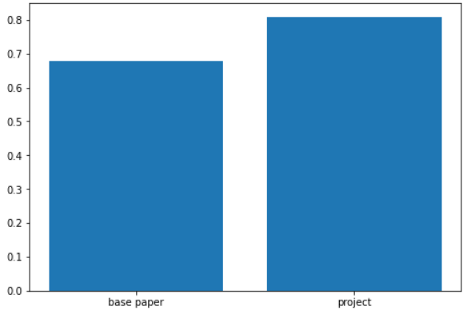
Result

Slide 8
Result
Hyperparameter setting
RandomizedSearchCV(cv=5, estimator=RandomForestRegressor(), n_jobs=1,
param_distributions={'max_depth': [5, 10, 15, 20, 25, 30],
'min_samples_leaf': [1, 2, 5, 10],
'min_samples_split': [2, 5, 10, 15,
100],
random_state=42, scoring='neg_mean_squared_error',
verbose=2)

Slide 9
Thank you
Group 2
Saksham Sharma
Aditya Raj Singh
Akhil Sahani
Ritik Nageshwar
Yash Sukhdeve

